Slide 1

AWS FinTech Production Architecture: Digital Banking Platform
Defending Architectural Decisions for Scalability, Security, and Cost Optimization

Slide 2

Project Overview: Business & Technical Requirements
Performance
Scale
Availability
Sustain 1,000 transactions per second (TPS) during peak loads, ensuring rapid processing.
Support a user base of 500,000 concurrent users with seamless experience.
Maintain 99.9% availability SLA with robust fault tolerance measures.
Compliance
Cost Efficiency
Adhere to SOC2 compliance for data security and operational integrity.
Achieve a 40% cost optimization target through strategic resource utilization.

Slide 3
Architecture Design Goals: Pillars of Excellence
Scalability
Security
Reliability
Dynamic scaling to handle variable loads and user growth without performance degradation.
End-to-end data protection, access control, and compliance adherence.
High availability, fault tolerance, and rapid recovery from failures.
Cost Optimization
Performance
Efficient resource provisioning and cost-effective operational strategies.
Low latency, high throughput, and responsive user experience.

Slide 4
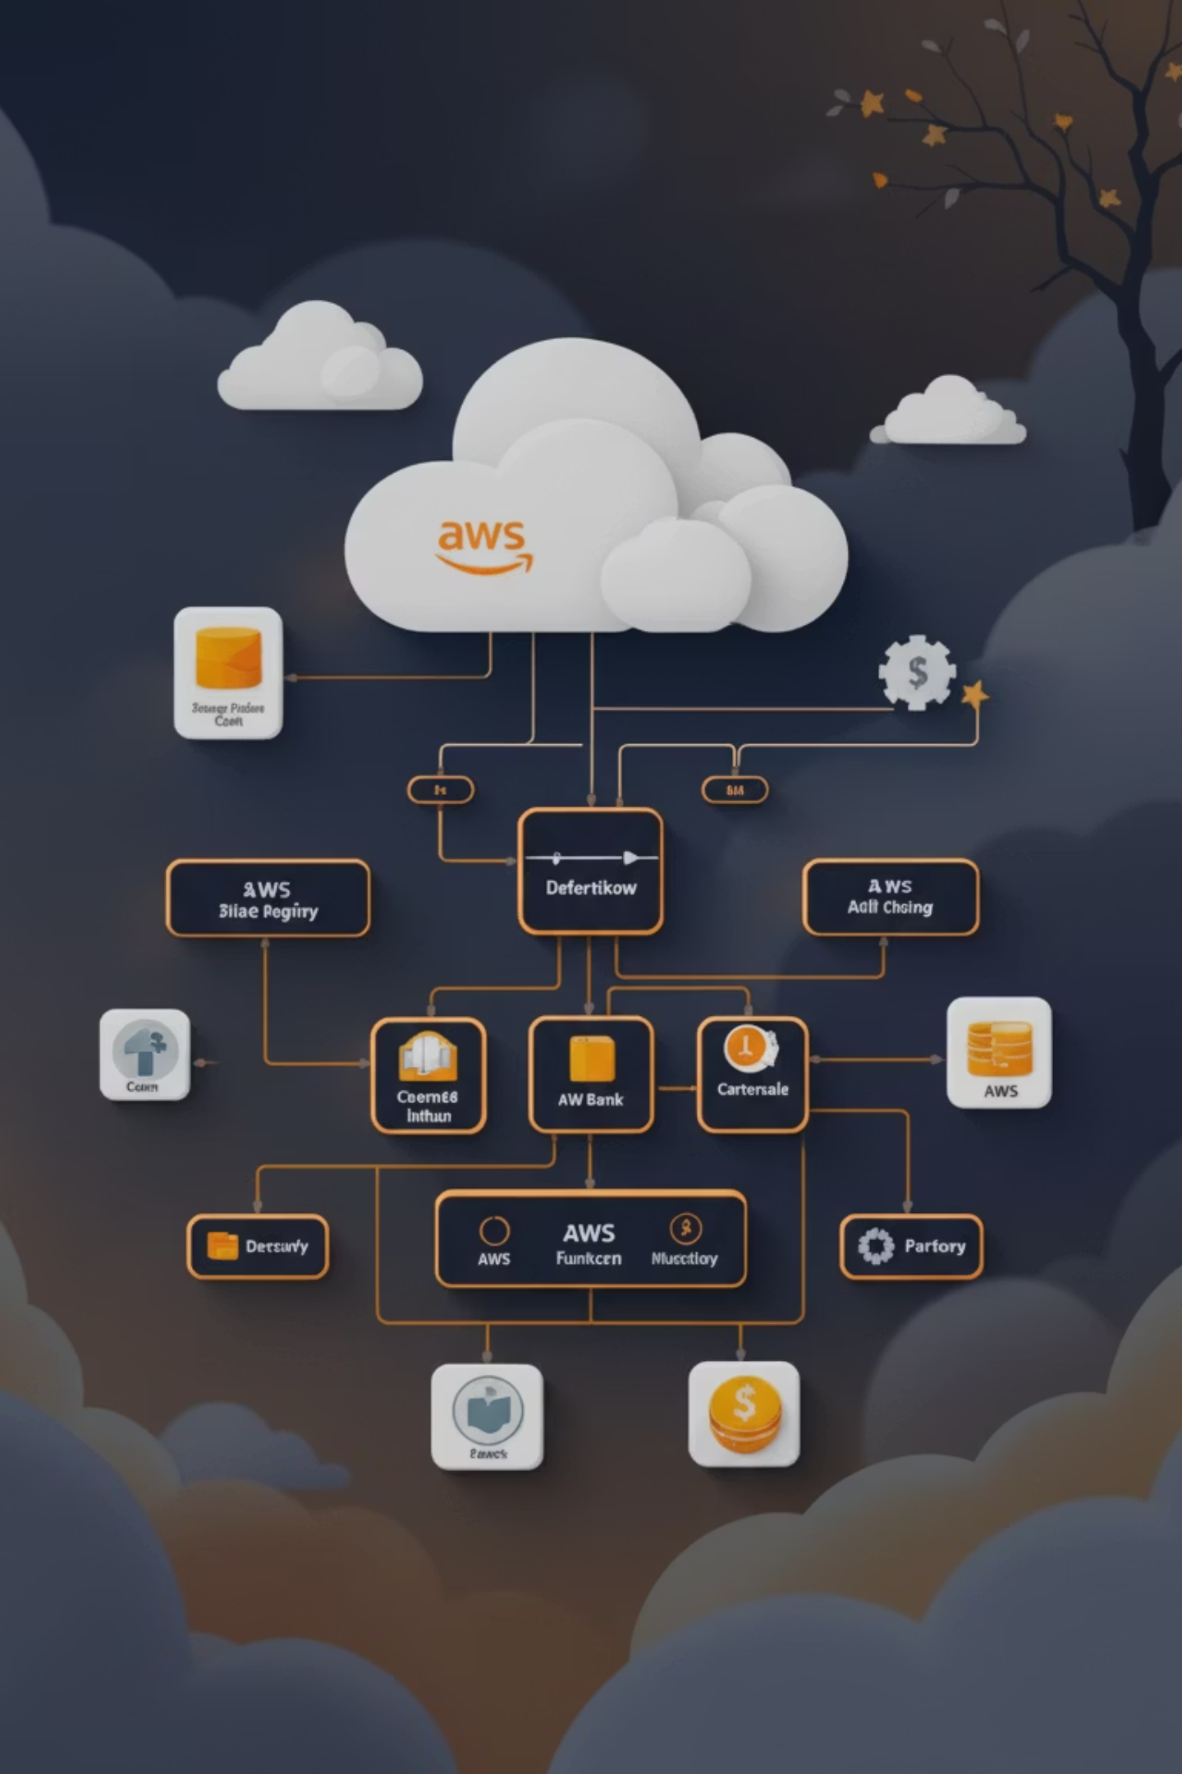
High-Level System Architecture: Digital Banking Platform
Our platform is built on a robust, scalable, and secure AWS foundation in us-east-1.
Leverages AWS services for global content delivery, intelligent load balancing, containerized compute, and managed database services.
Designed for multi-AZ resilience and automated scaling to meet demand fluctuations.

Slide 5
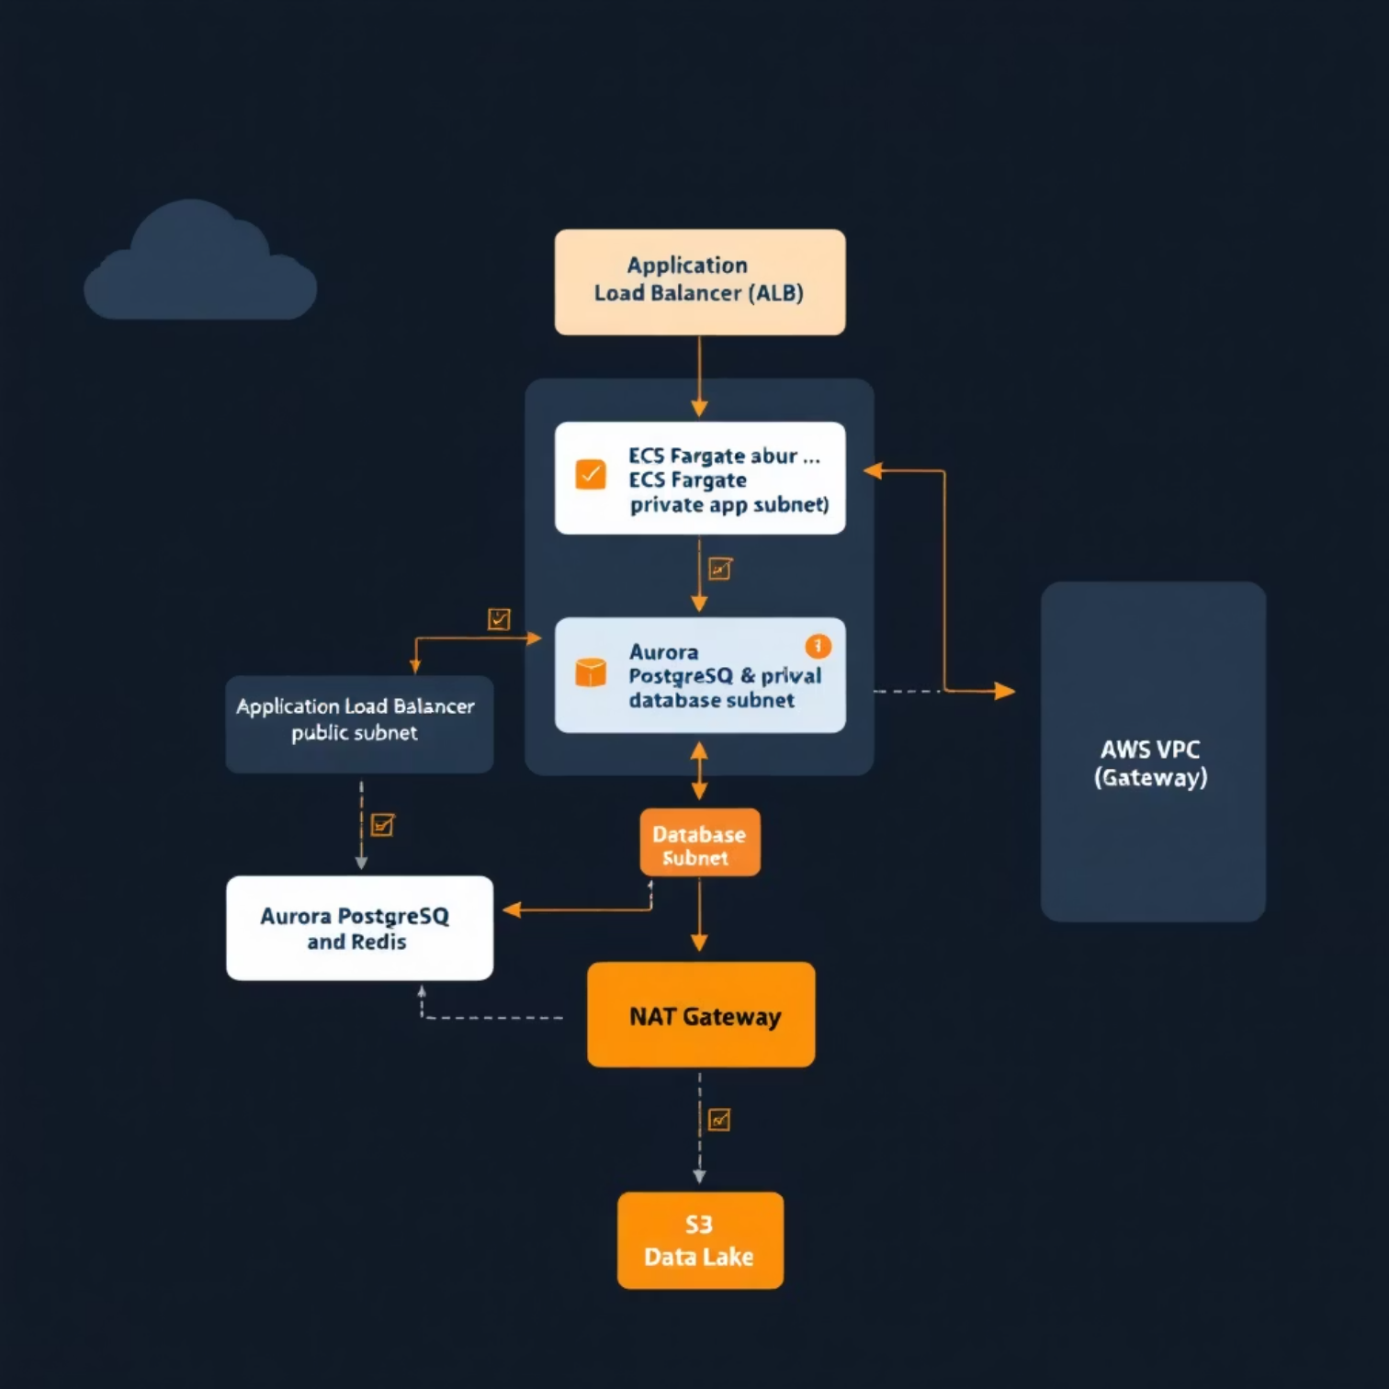
Network & VPC Architecture: Isolated and Secure
NETWORKING LAYER
Our Virtual Private Cloud (VPC) is strategically segmented:
• Public Subnets: Application Load Balancer (ALB) for internet-facing traffic.
• Private App Subnets: ECS Fargate tasks for containerized compute.
• Private Database Subnets: Aurora PostgreSQL and ElastiCache Redis for data persistence.
• NAT Gateway: Secure outbound access for private subnets.

Slide 6


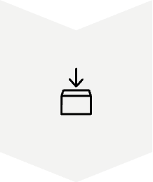

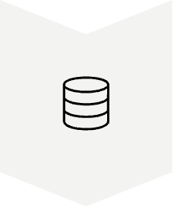

Traffic Flow & Request Lifecycle: Optimized for Performance
Client Request
User initiates transaction via web or mobile app.
CloudFront CDN
Caches static content, reduces latency, and protects against DDoS attacks.
Application Load Balancer (ALB)
Distributes traffic across ECS Fargate tasks in multiple AZs.
ECS Fargate
Processes requests, interacts with data layers (Aurora, DynamoDB, Redis).
Data Layers
Stores and retrieves transactional data, user sessions, and cached information.
Response
Data returned to client via the same optimized path.

Slide 7
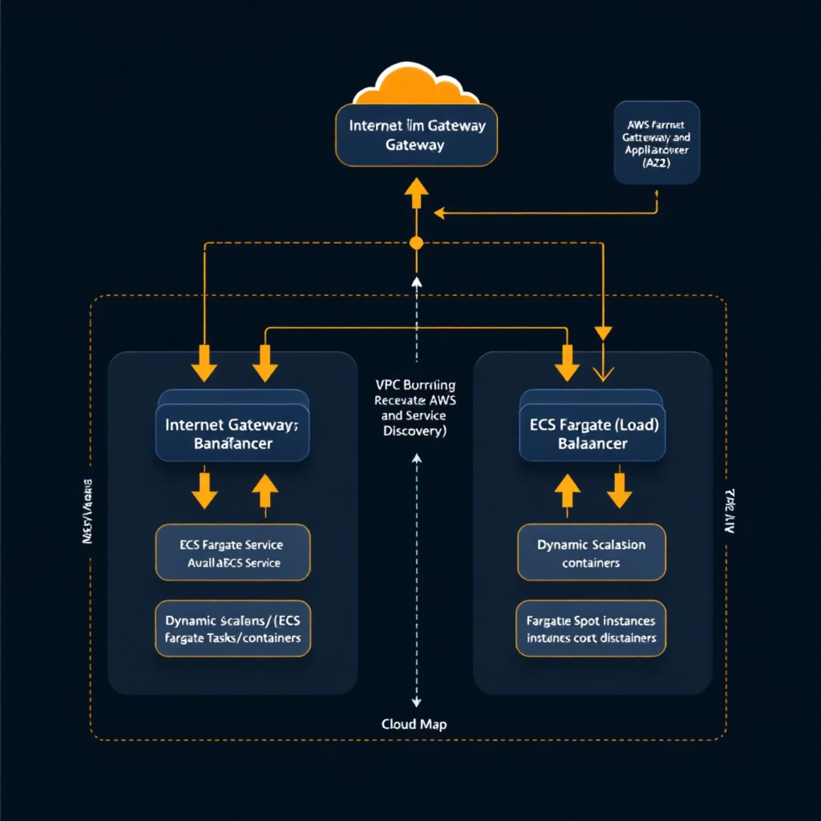
COMPUTE LAYER
Compute Layer – ECS Fargate
ECS Fargate (Serverless Containers)
Eliminates infrastructure management.
Multi-AZ Deployment
High availability and fault tolerance.
Auto Scaling Policies
Dynamic resource allocation based on demand.
AWS Cloud Map
Service discovery and inter-service communication.
Immutable Deployments
Blue/Green strategy for safe rollouts.

Slide 8

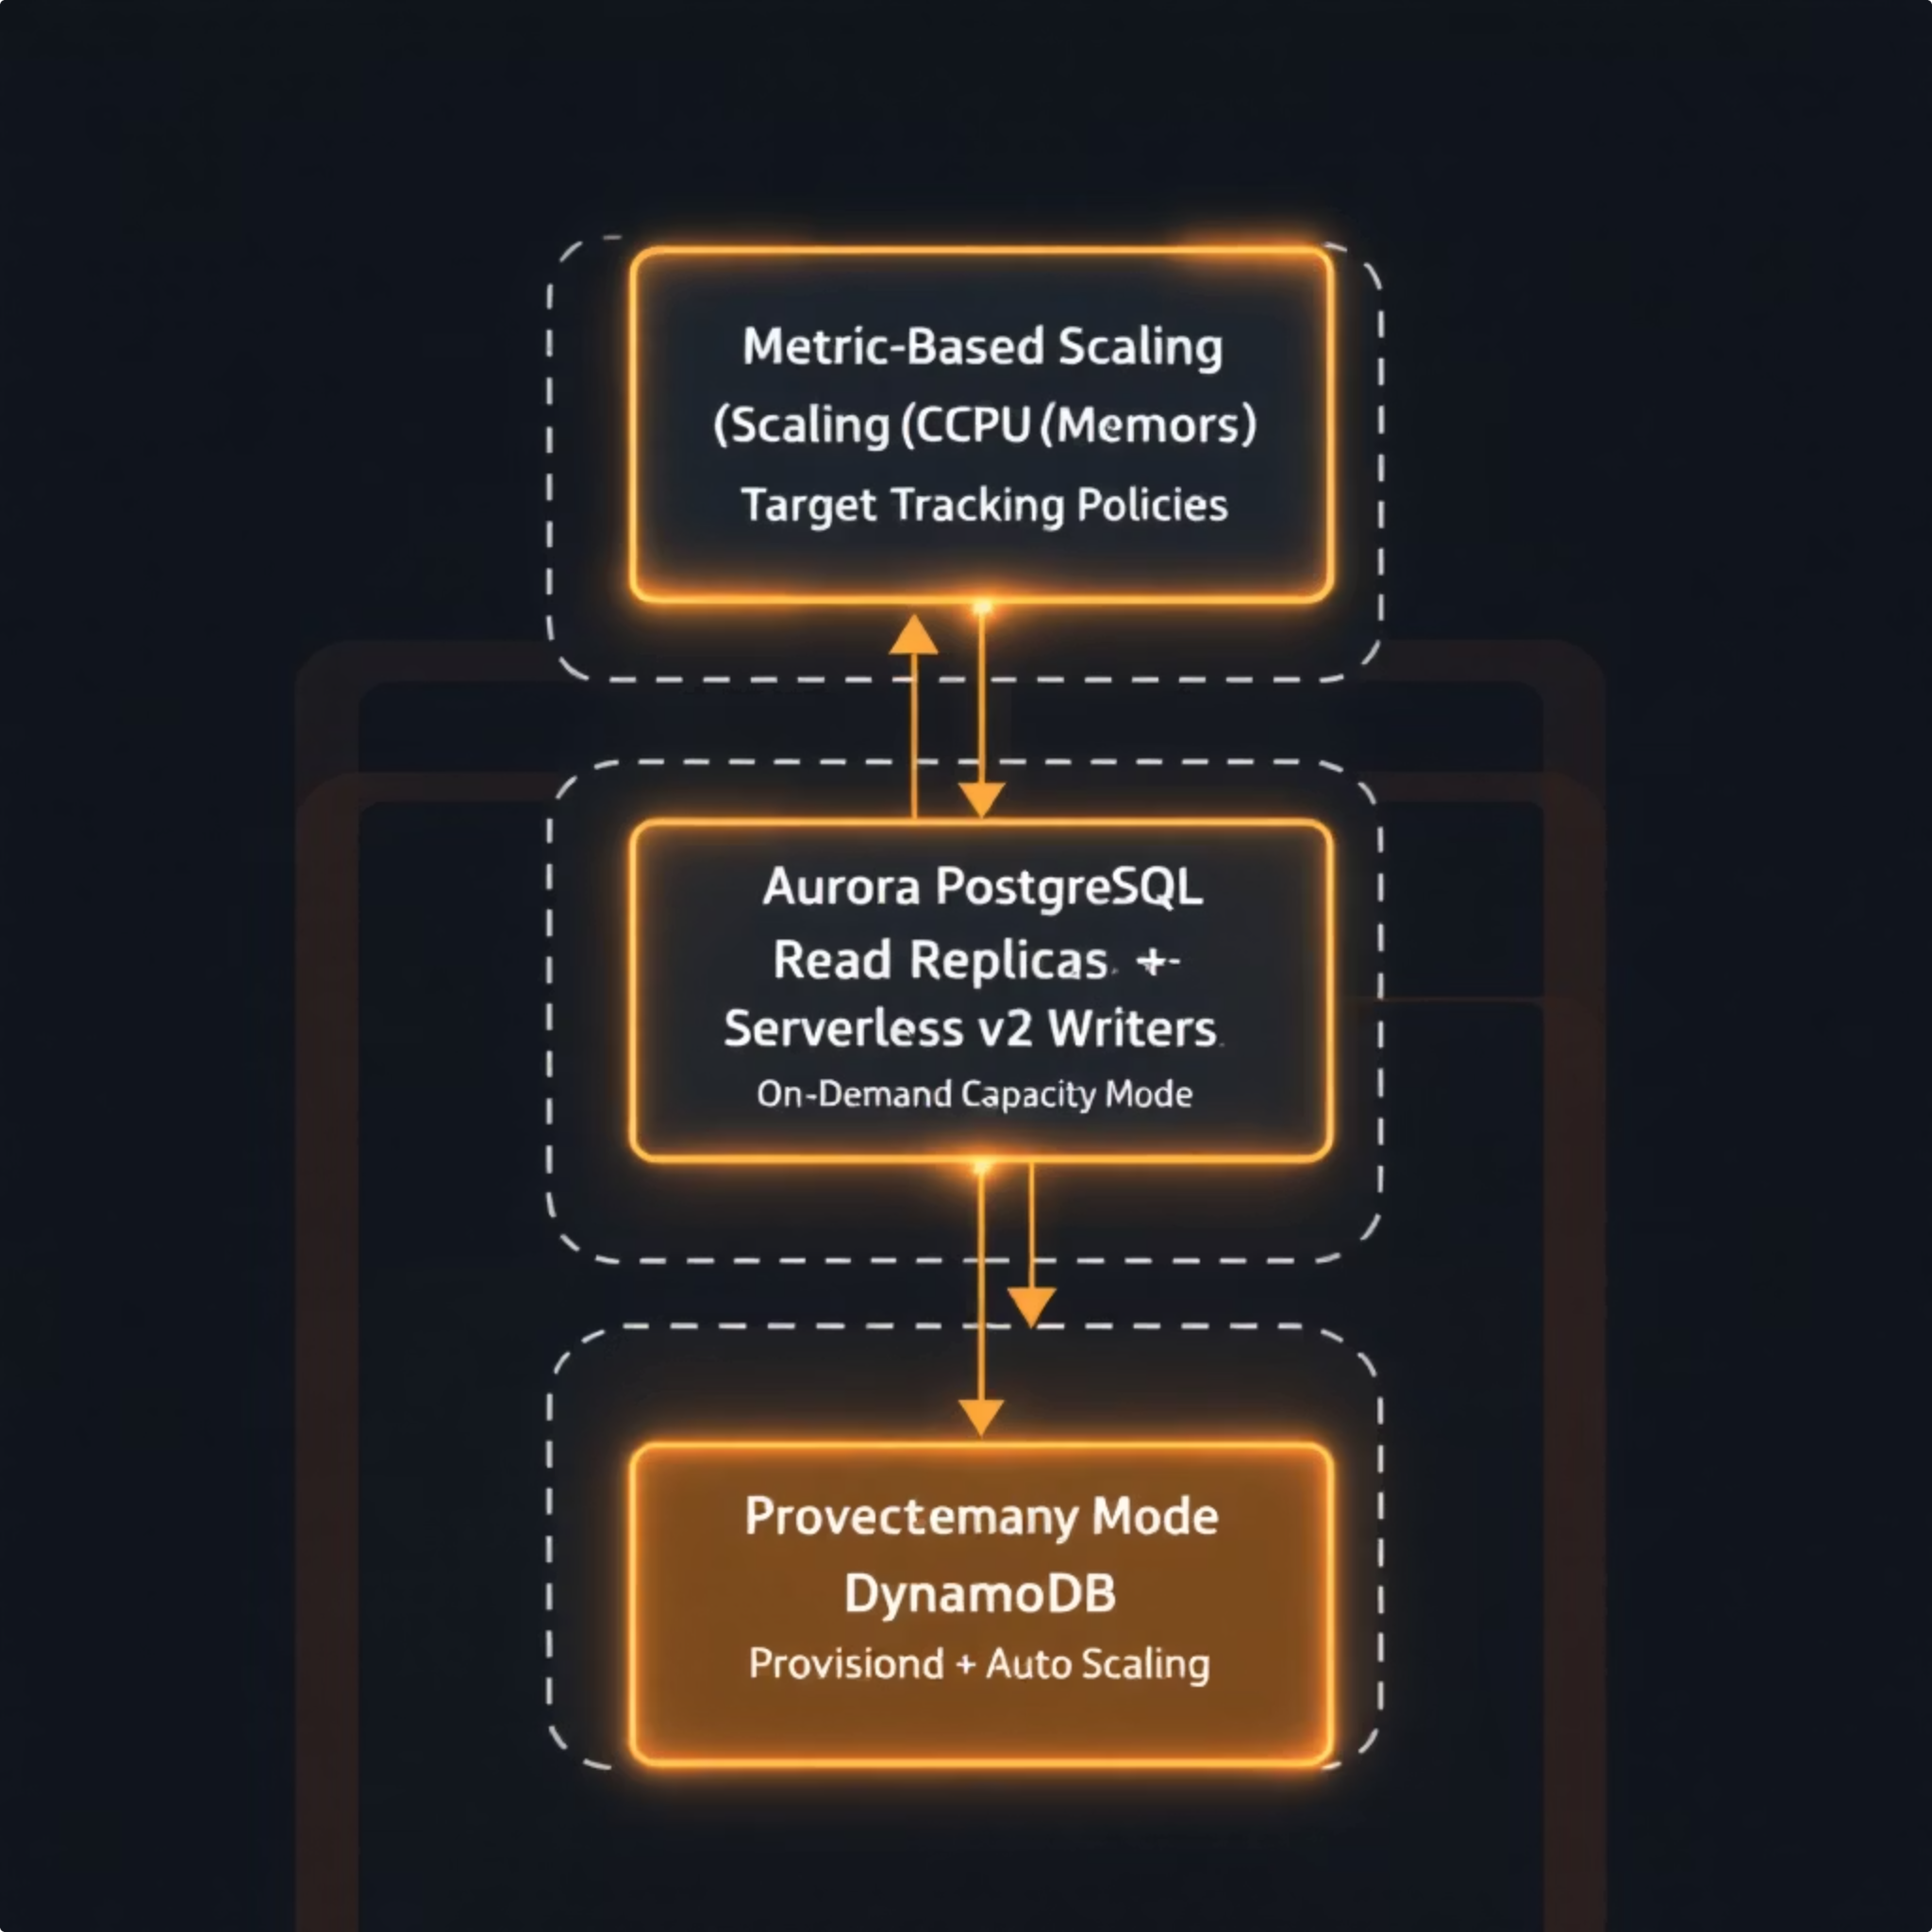
Auto Scaling Strategy: Dynamic Resource Allocation
Proactive and reactive scaling ensures optimal performance and cost efficiency.
1
ECS Fargate
Metric-based scaling (CPU/Memory utilization).
Target Tracking scaling policies for consistent performance.
2
Aurora PostgreSQL
Aurora Auto Scaling for read replicas based on CPU/connections.
Serverless v2 for dynamic capacity adjustments on writers.
3
DynamoDB
On-demand capacity mode for unpredictable workloads.
Provisioned capacity with Auto Scaling for predictable traffic patterns.

Slide 9
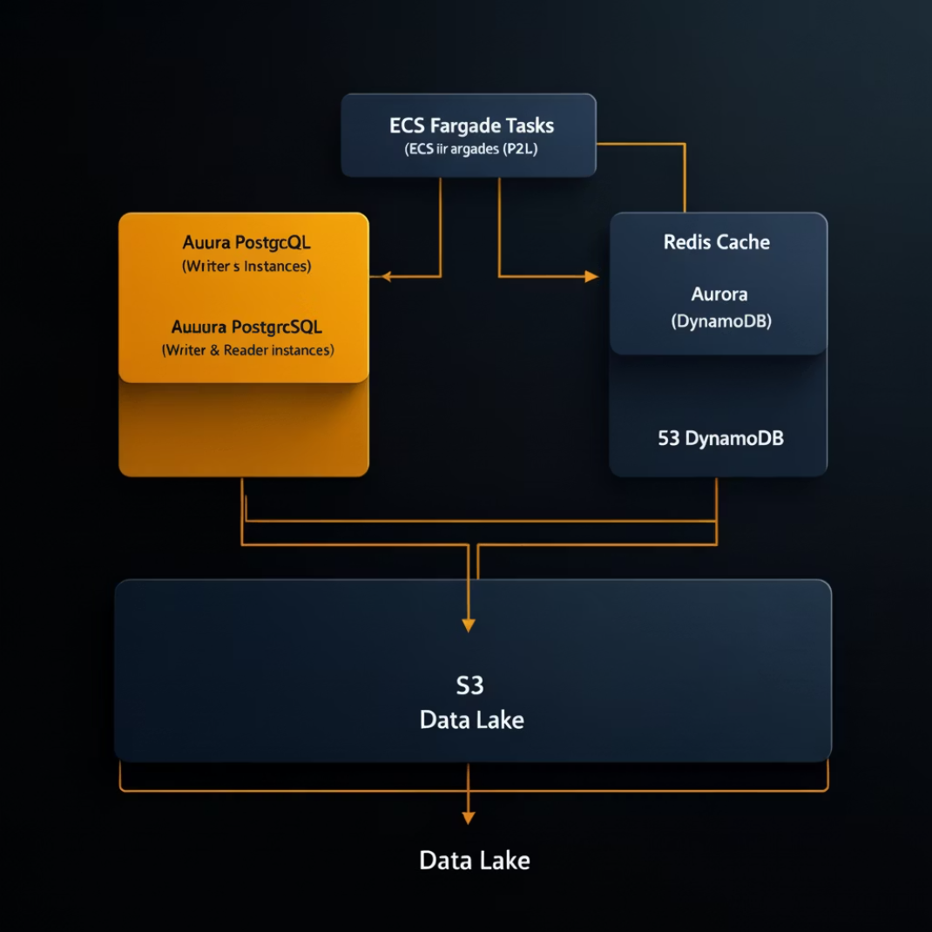
DATA LAYER
Data Layer Architecture: Resilient and Performant
A multi-tiered data strategy for diverse data needs.
Aurora PostgreSQL
Multi-AZ cluster with reader/writer instances for high availability and read scaling of transactional data.
DynamoDB
NoSQL database for high-throughput user sessions, caching, and transient data with on-demand scaling.
ElastiCache Redis
Multi-AZ replication group for low-latency caching and session management, reducing database load.
S3 Data Lake
Encrypted (KMS), versioned, with lifecycle policies for long-term storage of audit logs, analytics data, and backups.

Slide 10

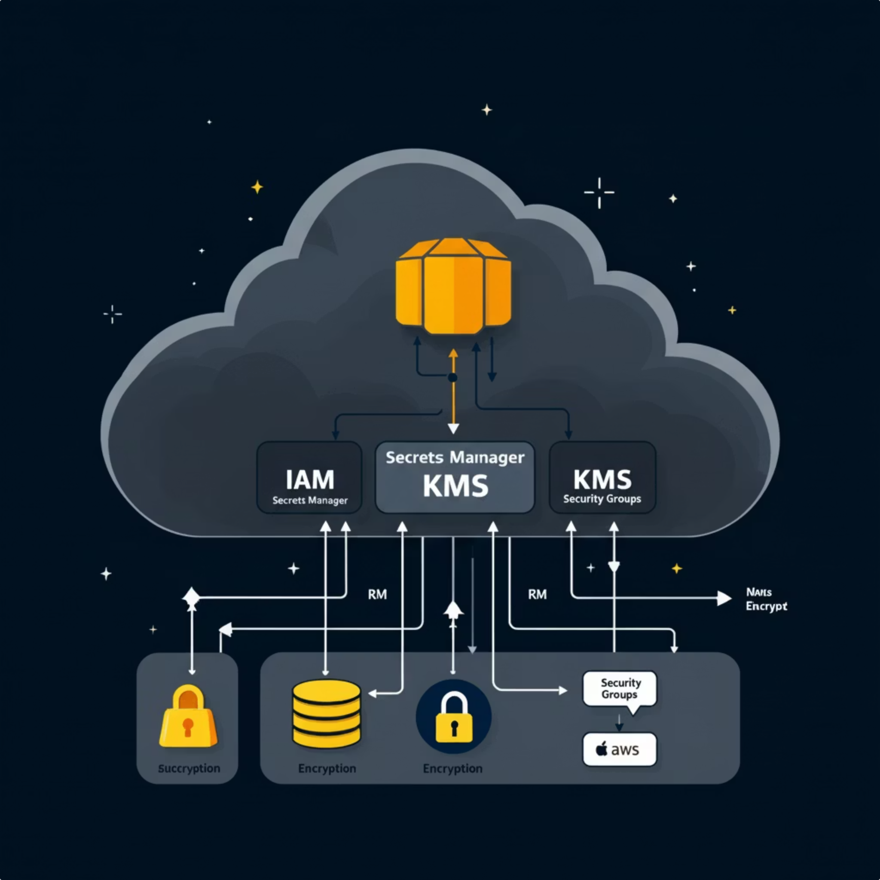
SECURITY LAYER
Secrets Management & Security Architecture
Robust security controls are integrated throughout the architecture.
Secrets Manager
Centralized management and rotation of database credentials, API keys, and other sensitive information.
KMS Encryption
Manages encryption keys for data at rest (S3, Aurora, EBS) and in transit, ensuring data confidentiality.
Security Groups & NACLs
Fine-grained network access control at instance and subnet levels.
IAM Roles & Policies
Least privilege access for all AWS resources, enforcing strict authorization.

